Slide 1
Project Management
Project Planning and Scheduling
PERT/CPM

Slide 2
Project planning and Scheduling techniques:
Work breakdown structure (WBS).
Network:
Arrow scheme.
Node scheme.
Precedence diagram.
Program Evaluation and Review Technique (PERT).
Critical Path Method (CPM).
Gantt chart.
Time / Cost analysis.
Resource leveling.

Slide 3
Defining activities
A project is:
Composed of a number of activities
May start when at least one of its activities is ready to start
Completed when all its activities are completed

Slide 4
Defining activities -continued
An activity
Must have clearly defined start and end-points
Must have resource requirements that can be forecast: these are assumed to be constant throughout the project
Must have a duration that can be forecast
May be dependent on other activities being completed first (precedence networks)
Notes:
Where some of these assumptions do not apply (e.g. clearly defined start and end-points, certainty of durations) there are more complicated techniques that can be applied, e.g. PERT risk – see Section 7.10.

Slide 5
Project Scheduling Steps
Establishing objectives
Determining available resources
Sequencing activities
Identifying precedence relationships
Determining activity times & costs
Estimating material & worker requirements
Determining critical activities

Slide 6
PERT/CPM
PERT
Program Evaluation and Review Technique
Developed by U.S. Navy for Polaris missile project
Developed to handle uncertain activity times
CPM
Critical Path Method
Developed by Du Pont & Remington Rand
Developed for industrial projects for which activity times generally were known
Today’s project management software packages have combined the best features of both approaches.

Slide 7
PERT/CPM
PERT and CPM have been used to plan, schedule, and control a wide variety of projects:
PERT/CPM is used to plan the scheduling of individual activities that make up a project.
Projects may have as many as several thousand activities.
A complicating factor in carrying out the activities is that some activities depend on the completion of other activities before they can be started.

Slide 8
PERT/CPM
Project managers rely on PERT/CPM to help them answer questions such as:
What is the total time to complete the project?
What are the scheduled start and finish dates for each specific activity?
Which activities are critical and must be completed exactly as scheduled to keep the project on schedule?
How long can noncritical activities be delayed before they cause an increase in the project completion time?

Slide 9
PERT/CPM
Before building precedence diagram , we have to ask ourselves four questions:
Can this activity be done first?
What activities must be completed before this one can start?
What activities must be carried out at the same time with this one?
What activities cannot start until this one is complete?

Slide 10
Project Network
A project network can be constructed to model the precedence of the activities.
The nodes of the network represent the activities.
The arcs of the network reflect the precedence relationships of the activities.
A critical path for the network is a path consisting of activities with zero slack.

Slide 11
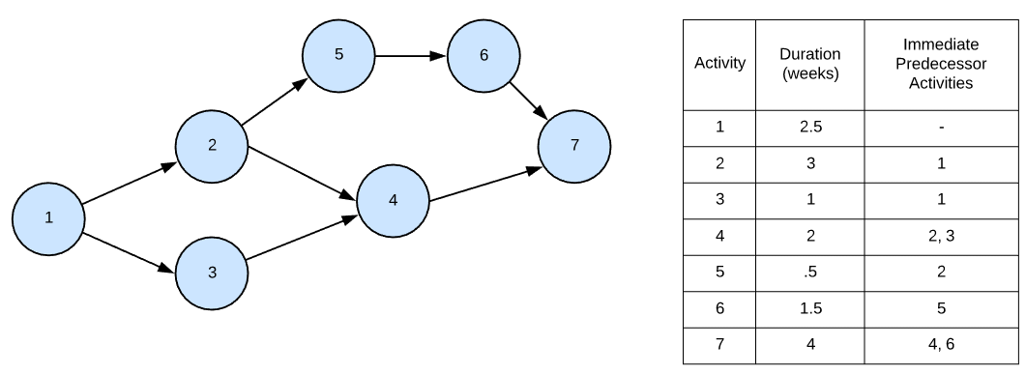
Project network

Slide 12
Drawing up a PERT diagram
No looping back is allowed – deal with iterations by hiding them within single activities
milestones – ‘activities’, such as the start and end of the project, which indicate transition points. They have zero duration.

Slide 13
Lagged activities
where there is a fixed delay between activities e.g. seven days notice has to be given to users that a new release has been signed off and is to be installed
Acceptance
testing
7days
Install new
release
20 days
1day
Notes:
See Section 6.8 ‘Formulating a network model’ page 143 for lagged activities.

Slide 14
Types of links between activities
Finish to start
Start to start/ Finish to finish
Software
development
Acceptance testing
Test prototype
2 days
Document
Amendments
1 day
Notes:
Finish to start: The following activity starts when the previous one has been finished
e.g. testing starts when coding has been completed
Start to start: When one activity starts another has to start as well
e.g. when prototype testing starts amendment documentation has to start as well
Finish to finish: when one activity finishes the other must finish too
e.g. when the testing of the prototype is completed so is the documentation of any amendments
You could use these with lags e.g. documentation of the changes to the prototype starts 1 day after the testing and finishes 2 days after testing has been completed

Slide 15
Types of links between activities
Start to finish
Operate temporary
system
when the cutover to the new system takes place, the operation of the temporary system is no longer needed
Acceptance test
of new system
Cutover to new
system
cutover starts after acceptance testing
Notes:
Start to finish – in the example when the cutover to the new system takes place, the operation of the temporary system is no longer needed. Although the cutover depends of the acceptance testing to be completed, the implication is that
the cutover might not start straight after acceptance testing.

Slide 16
Using Critical Path Analysis to Make Schedule Trade-offs
Free slack or free float is the amount of time an activity can be delayed without delaying the early start of any immediately following activities
A forward pass through the network diagram determines the early start and finish dates
A backward pass determines the late start and finish dates

Slide 17
CPM Diagram: Example
Activity | Predecessors | Time (days)
A | --- | 3
B | A | 3
C | A | 2
D | B | 3
E | C | 7
F | B,C | 3
G | D,E | 6
H | C | 2

Slide 18
Activity notation
EST | Duration | EFT
Activity name
LST | Slack | LFT
EST | Earliest Start Time
EFT | Earliest Finish Time
LST | Latest Start Time
LFT | Latest Finish Time
Slack | =LFT-EFT or LST-EST

Slide 19
Activity notation-2
Activity name | EST | EFT
Duration | LST | LFT
EST | Earliest Start Time
EFT | Earliest Finish Time
LST | Latest Start Time
LFT | Latest Finish Time
Slack | =LFT-EFT or LST-EST

Slide 20
Example: Draw the network first
PERT diagram
B
D
3
3
G
F
6
A
3
Start
Finish
3
E
C
7
H
2
2

Slide 21
Earliest Start and Finish Times
Step 1: Make a forward pass through the network as follows: For each activity i beginning at the Start node, compute:
Earliest Start Time (EST)= the maximum of the earliest finish times of all activities immediately preceding activity i. (This is 0 for an activity with no predecessors.)
Earliest Finish Time (EFT) = (Earliest Start Time) + (Time to complete activity i ).
The project completion time is the maximum of the Earliest Finish Times at the Finish node.

Slide 22
Example:
Earliest Start and Finish Times
B
3 6
D
6 9
3
3
G
12 18
F
6 9
6
A
0 3
3
Start
Finish
3
E
5 12
C
3 5
7
H
5 7
2
2
What is the project duration?
18 days

Slide 23
Latest Start and Finish Times
Step 2: Make a backwards pass through the network as follows: Move sequentially backwards from the Finish node to the Start node. At a given node, j, consider all activities ending at node j. For each of these activities, i, compute:
Latest Finish Time (LFT) = the minimum of the latest start times beginning at node j. (For node N, this is the project completion time.)
Latest Start Time (LST)= (Latest Finish Time) - (Time to complete activity i ).

Slide 24
Example: Cont.
Latest Finish time: Backward pass
consider all activities ending at node finish,
1. find LFT
B
3 6
D
6 9
3
3
G
12 18
F
6 9
6
18
3
18
A
0 3
Start
Finish
3
E
5 12
C
3 5
7
H
5 7
2
2
18

Slide 25
Example: Cont..
2. Find Latest start time = LFT - Duration
B
3 6
D
6 9
3
3
G
12 18
F
6 9
6
12 18
A
0 3
3
15 18
Start
Finish
3
E
5 12
C
3 5
7
H
5 7
2
2
16 18

Slide 26
Continue the backward pass for the rest of the nodes..
Latest Start and Finish Times for nodes ending at node G
(Nodes D and E)
B
3 6
D
6 9
3
3
9 12
G
12 18
F
6 9
6
12 18
A
0 3
3
15 18
Start
Finish
3
E
5 12
C
3 5
7
5 12
H
5 7
2
2
16 18

Slide 27
Latest Start and Finish Times for Node B
Node B has 2 Successor nodes (D & F)
LFT is the minimum LST of successor nodes = min(9,15)= 9
LST = LFT – Duration
= 9 - 3 =6
B
3 6
D
6 9
3
6 9
3
9 12
G
12 18
F
6 9
6
12 18
A
0 3
3
15 18
Start
Finish
3
E
5 12
C
3 5
7
5 12
H
5 7
2
2
16 18

Slide 28
Continue the backward pass for the rest of the nodes..
Latest Start and Finish Times
B
3 6
D
6 9
3
6 9
3
9 12
G
12 18
F
6 9
6
12 18
A
0 3
3
15 18
Start
Finish
3
0 3
E
5 12
C
3 5
7
5 12
H
5 7
2
3 5
2
16 18

Slide 29
Determining the Critical Path
Step 3: Calculate the slack time for each activity by:
Slack = (Latest Start) - (Earliest Start),
or
= (Latest Finish) - (Earliest Finish).

Slide 30
Critical Nodes: A, C, E and G
Critical path: A-> C->E->G
B
3 6
D
6 9
3
6 9
3
9 12
G
12 18
F
6 9
6
12 18
A
0 3
3
15 18
Start
Finish
3
0 3
E
5 12
C
3 5
7
5 12
H
5 7
2
3 5
2
16 18

Slide 31
Example:
Activity | Predecessors | Time (days) | EST | EFT | LST | LFT | Slack
A | --- | 3 | 0 | 3 | 0 | 3 | 0
B | A | 3 | 3 | 6 | 6 | 9 | 3
C | A | 2 | 3 | 5 | 3 | 5 | 0
D | B | 3 | 6 | 9 | 9 | 12 | 3
E | C | 7 | 5 | 12 | 5 | 12 | 0
F | B,C | 3 | 6 | 9 | 15 | 18 | 9
G | D,E | 6 | 12 | 18 | 12 | 18 | 0
H | C | 2 | 5 | 7 | 16 | 18 | 11

Slide 32
Example ..cont.
Determining the Critical Path
A critical path is a path of activities, from the Start node to the Finish node, with 0 slack times.
Critical Path: A – C – E – G
The project completion time equals the maximum of the activities’ earliest finish times.
Project Completion Time: 18 days

Slide 33
Example:
Critical Path using CPM
B
3 6
D
6 9
3
6 9
3
9 12
G
12 18
F
6 9
6
12 18
A
0 3
3
15 18
Start
Finish
3
0 3
E
5 12
C
3 5
7
5 12
H
5 7
2
3 5
2
16 18

Slide 34
Using Critical Path Analysis to Make Schedule Trade-offs
Free slack or free float is the amount of time an activity can be delayed without delaying the early start of any immediately following activities
Total slack or total float is the amount of time an activity may be delayed from its early start without delaying the planned project finish date
A forward pass through the network diagram determines the early start and finish dates
A backward pass determines the late start and finish dates

Slide 35
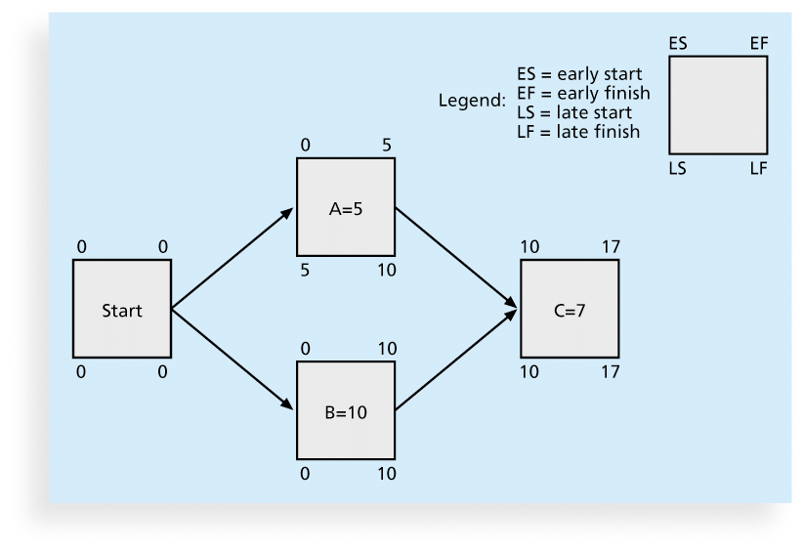
Figure 6-9. Calculating Early and Late Start and Finish Dates

Slide 36
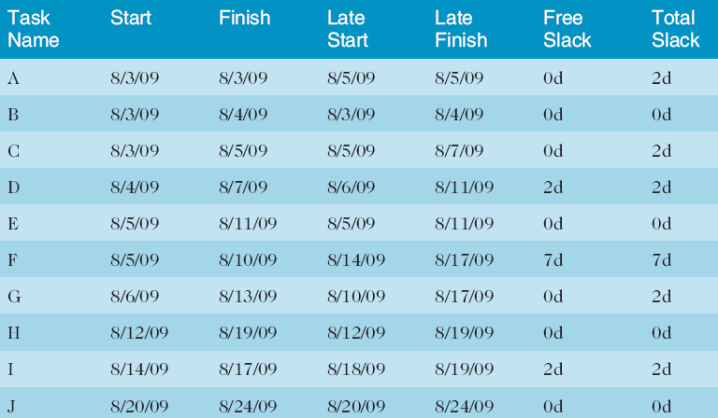
Table 6-1. Free and Total Float or Slack for Project X

